Slide 1
Predicting Food Inspection Outcomes in Chicago

Slide 2

CS 109A Data Science
Final Project
Fall 2016
Calvin J Chiew
Angelo Kastroulis
Tim Hagmann
(TF: Taylor Names)

Slide 3
Introduction

Slide 4
Problem
There are more than 15,000 food establishments in Chicago but fewer than three dozen food inspectors.
15% of these establishments will have at least one critical violation.
Many of them are discovered long after the violations have occurred, thereby exposing the public to risk of food-borne illnesses.

Slide 5
Solution
The City of Chicago developed a model (based on random forests) to forecast establishments with high likelihood of critical violations and prioritized them for inspections.
In a pilot study, the data-optimized order of inspections identified unsafe establishments earlier than the usual workflow, by 7.5 days on average.

Slide 6
Chicago’s Model
Prior history of critical violations
3-day average high temperature
Nearby sanitation complaints
Type of facility
Nearby burglaries
Tobacco/alcohol license
Length of time since last inspection
Length of business operation
Inspector assigned

Slide 7
Data

Slide 8
Data Sources
Chicago’s publicly available dataset of ~130,000 food inspections from 1 January 2010 to present
Requested daily climate data from National Centers for Environmental Information (NCEI)
Business licenses, crimes and sanitation code 311 complaints data accessed from Chicago’s data portal

Slide 9
Data Preparation
Transformed new variables, eg.
Days since last inspection
Proportion of past inspections failed
Most recent inspection outcome
5-day rolling mean of max temperature
Regrouped into broad categories:
Inspection type, facility type
Mapped to main dataset:
Climate data by date
Business licenses data by license ID
Crime & sanitation data by “cluster”

Slide 10
Data Exploration
Past failure, inspection type and geographical “cluster” are associated with failed outcome.
Failure rates tend to increase in the mid-year months corresponding to higher temperatures.
There is geographic variation in crimes and sanitation complaints which may be related to outcome.

Slide 11
Fig 1: Selected Predictors
TO ADD GRAPHS HERE

Slide 12
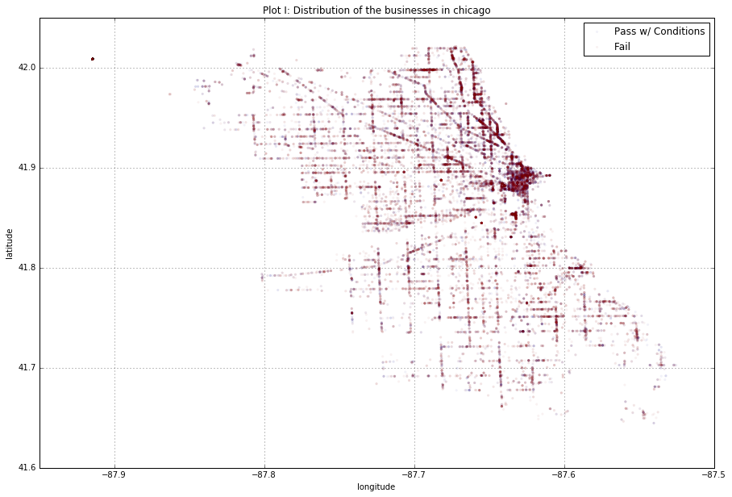
Fig 2: Geographic Location/Cluster
PLACEHOLDER IMAGE

Slide 13
Model Fitting

Slide 14
Baseline Models
We handled missing values, applied one-hot encoding to categorical variables, and split data into training and test sets in 7:3 ratio.
Using a binary outcome (pass/fail), we created an “all-zero” model predicting all inspections to fail, and a “random label” model predicting failures based on overall proportion.

Slide 15
Classification Models
We explored various classifiers and used logistic regression as an ensemble method to “stack” all the models.
We tuned the parameters of our models via cross-validation (time series cross-validator used to prevent information on lag predictors leaking across validation sets).

Slide 16
Model Evaluation

Slide 17
Statistical Evaluation
Overall test accuracies of the various models are shown in Table 1.
The by-class test accuracies reflect the sensitivity and specificity of the models, which relate to their F1 score. ROC curves are shown in Fig 3.

Slide 18
“Real-life” Evaluation
Using another independent test set (last 2 months), simulate predicting failures and prioritizing inspections.
When model was used to order inspections, score average number of days earlier (or later) failures were inspected compared to the actual dates, and proportion of failures caught in the first month.

Slide 19
Table 1: Model Test Accuracies
Model | Test Accuracy (%)
 | Overall | “Pass” class (Specificity) | “Fail” class (Sensitivity)
Baseline Models
All zero | 22.57 | 0.00 | 100.00
Random label | 34.58 | 22.16 | 77.21
Candidate Models
Logistic regression (weighted) | 70.59 | 64.20 | 92.52
Linear discriminant analysis (LDA) | 77.63 | 96.45 | 13.08
Quadratic discriminant analysis (QDA) | 77.56 | 99.34 | 2.81
Random forest (RF) | 82.13 | 91.82 | 48.91
Support vector machine (SVM) | 77.88 | 99.58 | 2.22
ADA boost (ADA) | 80.79 | 91.85 | 42.85
Ensemble | 82.13 | 91.82 | 48.91

Slide 20
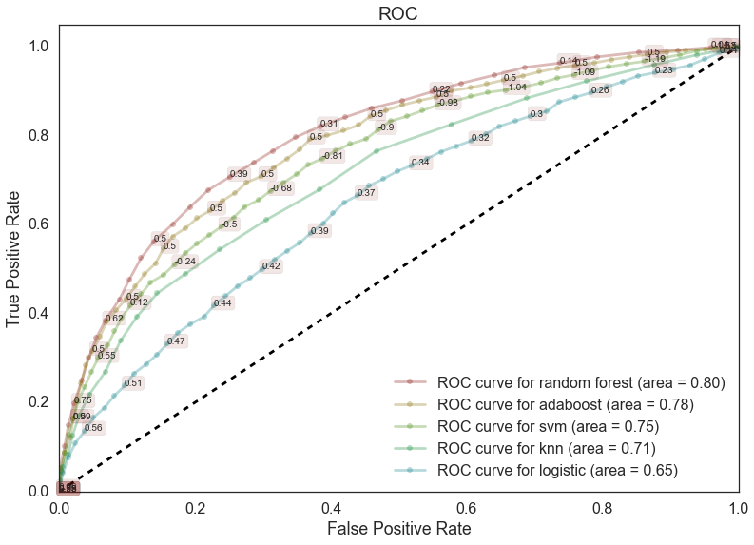
Fig 3: Model ROC curves
PLACEHOLDER IMAGE

Slide 21
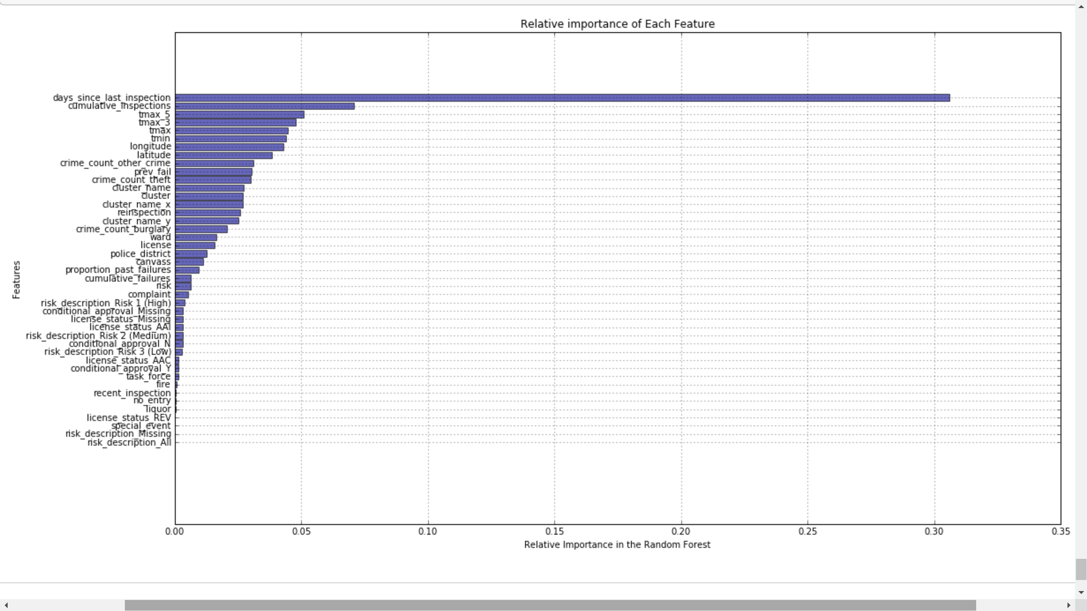
Fig 4: Feature importance rank
Relative importance of features in the random forest
TO PRETTIFY
THIS GRAPH

